Slide 1
Regional Organization - How to Get to 100 Angels Regions

Slide 2
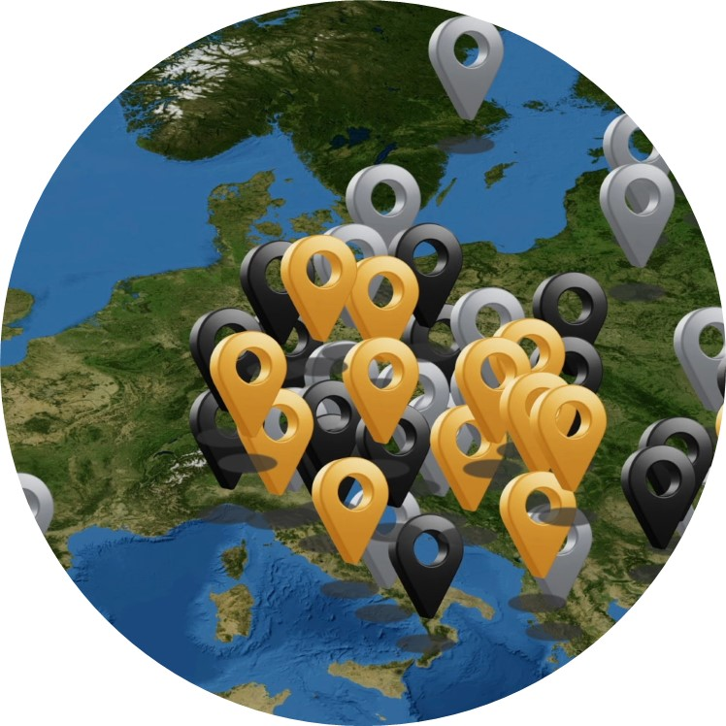
The mission needs to be very specific
HAVE ENOUGH STROKE-READY HOSPITALS TO COVER THE POPULATION
IMPROVE & MAINTAIN THE QUALITY OF EXISTING STROKE CENTERS

Slide 3
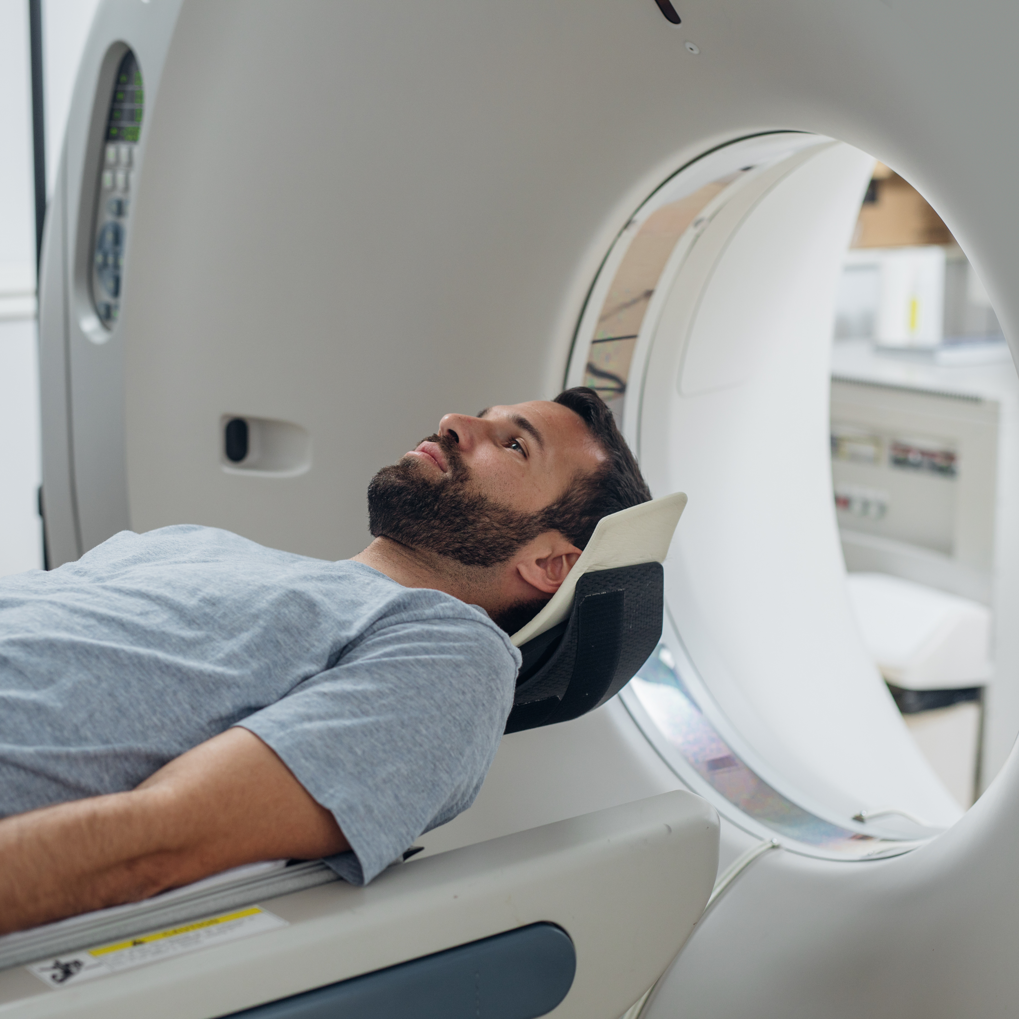
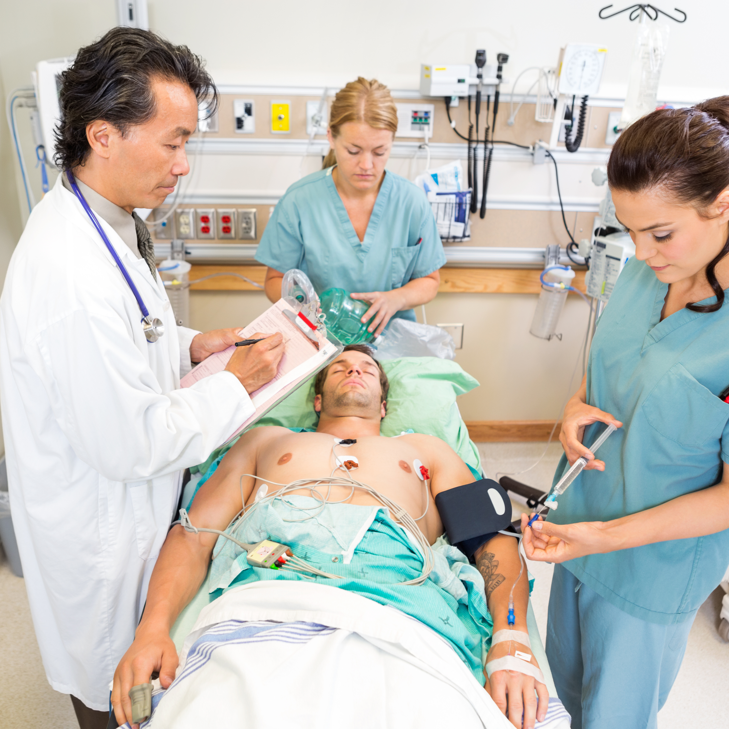
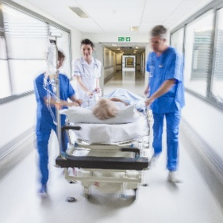
Stroke care is a chain that needs a regional approach
DETECTION / EMS
ACTIVATION
ED ADMISSION/
DATA COLLECTION
REPERFUSION
REHAB TRANSFERS
1
3
5
7
DISPATCH/ DELIVERY
DECISION
ADMISSION TO STROKE UNIT
TRANSFER FOR EVT
2
4
6

Slide 4
Four pillars of stroke excellence – becoming an Angels Region!
STROKE EXCELLENCE
AWARENESS
EMS
SC COVERAGE
SC PERFORMANCE
Sufficient coverage with FAST Heroes
All EMS in region have GOLD
≥80% hospital coverage
All SC in region have GOLD
SC – Stroke Center

Slide 5
Join THE MOVEMENT
Implementation of awareness campaign
Achieve gold status in the EMS Angels Awards
Have enough stroke-ready hospitals
Get all hospitals to gold in the ESO/WSO Angels Awards

Slide 6
ANGELS REGION
Reach awareness education target
Awareness education must meet an agreed target* for FAST Heroes implementation** in elementary schools in the region.
Tips for implementation…
Involve local authorities responsible for health and education
Collaborate with local patient
support organizations to reach more schools
Ask hospitals and EMS to help get more schools involved
Work with FAST Heroes agencies (where available) to register schools and train teachers
* The number of FAST Heroes participants required for Angels Region status is 0,5 of stroke incidence in the region.
** Other awareness programs may qualify for this target. These will be evaluated on a case by case basis.

Slide 7
ANGELS REGION
Award level criteria
 | GOLD | PLATINUM | DIAMOND
Median time on scene (minutes) | 31 - 35 min | 25 - 30 min | < 25 minutes
% pre-notification to hospital | 85% | 90% | 95%
% of patients delivered to stroke-ready hospitals | 85% | 90% | 95%
% of patients where medications details are reported | 85% | 90% | 95%
% of patients where time last known normal is reported | 85% | 90% | 95%
Achieve at least
status
in the EMS Angels Awards
EMS companies must capture patient data in RES-Q and meet the criteria for gold status in the EMS Angels Awards.
To be eligible EMS services must…
Have a formal
stroke protocol
Offer an annual stroke education program
Make use of specific stroke scale
Submit data for at least 30 consecutive stroke patients per quarter

Slide 8
ANGELS REGION
ANGELS REGION
Reach targets for hospital
Reach targets for hospital
Reach the optimal number of stroke-ready hospitals for the region as determined by population and geography and agreed with the regional coordinator.
All hospitals in the stroke network must meet the criteria for gold status in the WSO/ESO Angels Awards. Hospital data must be captured in RES-Q or SITS.

Slide 9
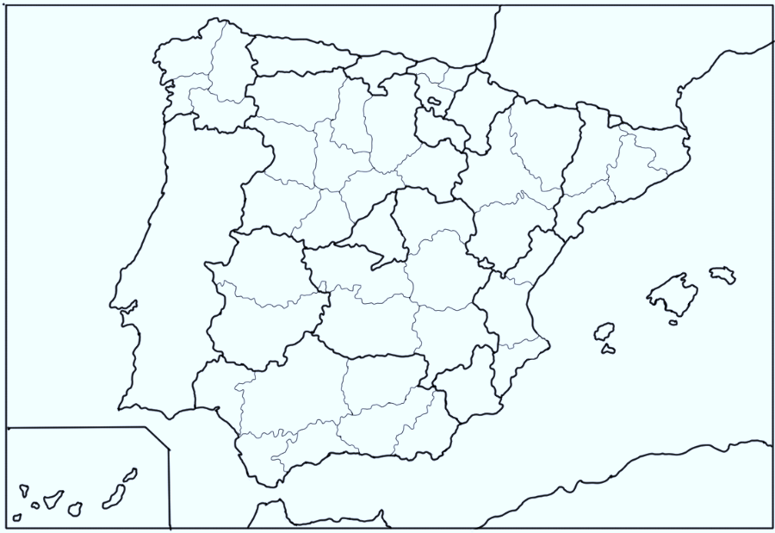
Territorial Division EU: NUT 1, NUT 2 and NUT 3
The NUTS classification (Nomenclature of territorial units for statistics) is a hierarchical system for dividing up the economic territory of the EU and the UK. The second level is what we want to focus on for Angels Regions.
FIRST LEVEL
SECOND LEVEL
Spanish Regions: NUTS-1
Spanish Regions: NUTS-2
Spanish Regions: NUTS-3
`
`
`
Recommended minimum and maximum population thresholds for the Angels Regions
NUTS 3: 150,000 – 800,000 inhabitants

Slide 10
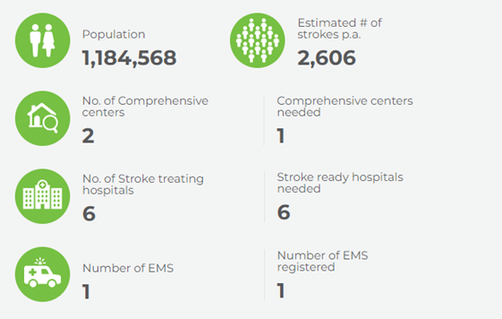
Stroke Center Coverage
It is necessary to agree on the optimal number and location of stroke hospitals in the region to offer all patients good access to stroke care. Several points will be considered in this process. The final agreed number will be termed our “Regionally Agreed Target”. It should be noted that this is an aspirational figure, even if this number has not yet been reached.
Points to consider in determining the Regionally Agreed Target:
Geographical coverage. Look at the stroke hospitals in a region and determine if the regional coverage is geographically adequate. You can use the mapping tool on the Angels website. The map shows a driving distance of 45 minutes around each hospital. If an area is not well covered, consider looking for a hospital in that area that could be part of the Stroke Network.
The Formula. The column on the left shows the number of hospitals needed based on the population and the estimated stroke incidence in this region. If a more accurate number for the incidence is available, please feel free to update the formula. The formula is based on the premise that in a good system every hospital admits around 500 stroke patients a year. Reducing the number of hospitals to a number lower than suggested by the formula is possible, but the following implications must be considered.
Driving distances. Fewer hospitals might mean longer driving distances.
Monitored beds needed. Fewer hospitals mean higher numbers of patients per hospital per year and therefore more monitored beds needed. The guidelines recommend that all stroke patients should be admitted to a stroke unit and closely monitored for at least 72 hours. 500 patients would mean a hospital would need around 6 monitored beds.
The Angels team can provide you with an Excel file to determine the Regionally Agreed Target number.
Example:

Slide 11
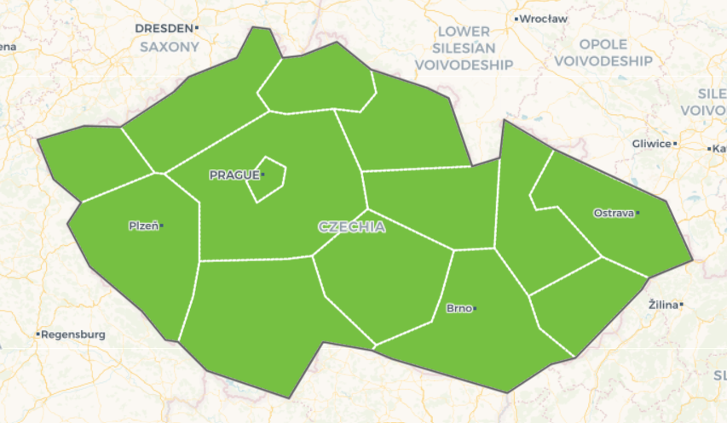
Regions overview – Czech Republic 2023
Region | Coverage | Hospital Performance | EMS Performance | Awareness | Region Status
Liberecký kraj | 100% | 50% | 0% | 0% | No
Královéhradecký kraj | 100% | 100% | 0% | 0% | No
Pardubický kraj | 100% | 0% | 100% | 4.59% | No
Jihočeský kraj | 100% | 66.67% | 100% | 109.26% | No
Plzeňský kraj | 100% | 0% | 100% | 0% | No
Moravskoslezský kraj | 100% | 83.33% | 100% | 104.01% | No
Karlovarský kraj | 100% | 100% | 100% | 90% | No
Ústecký kraj | 100% | 83.33% | 100% | 2.96% | No
Olomoucký kraj | 100% | 100% | 0% | 4.73% | No
Zlínský kraj | 100% | 0% | 100% | 0% | No
Středočeský kraj | 100% | 40% | 0% | 1.5% | No
Kraj Vysočina | 100% | 100% | 100% | 3.6% | No
Jihomoravský kraj | 100% | 83.33% | 100% | 137.45% | No
Hlavní město Praha | 100% | 100% | 0% | 0% | No
COVERAGE

Slide 12
Stroke center performance for GOLD status in WSO/ESO Angels Awards
 | GOLD STATUS | PLATINUM STATUS | DIAMOND STATUS
% of ischaemic stroke patients treated with door to needle time <= 60 minutes | 50% | 75% | 75%
% of ischemic stroke patients treated with door to needle time <= 45 minutes |  | <50% | 50%
% of ischemic stroke patients treated with door to groin time <= 120 minutes | 50% | 75% | 75%
% of ischemic stroke patients treated with door to groin time <= 90 minutes |  | <50% | 50%
% recanalization procedure rate out of total ischemic incidence | 5% | 15% | 25%
% of all suspected stroke patients undergoing CT/MR imaging procedure | 80% | 85% | 90%
% of all stroke patients undergoing dysphagia screening | 80% | 85% | 90%
% of non-atrial fib ischemic/TIA stroke patients prescribed antithrombotics at discharge | 80% | 85% | 90%
% of atrial fib ischemic/TIA stroke patients prescribed anticoagulants at discharge | 80% | 85% | 90%
Stroke patients treated in a dedicated stroke unit or ICU during their hospital stay |  |  | YES
50%
50%
5%
80%
DTN <60 minutes
DTG <120 minutes
Recanalization rate
Undergoing CT/MR
80%
80%
80%
Undergoing dysphagia screening
Non-AF prescribed antiplatelet
AF prescribed anticoagulants

Slide 13
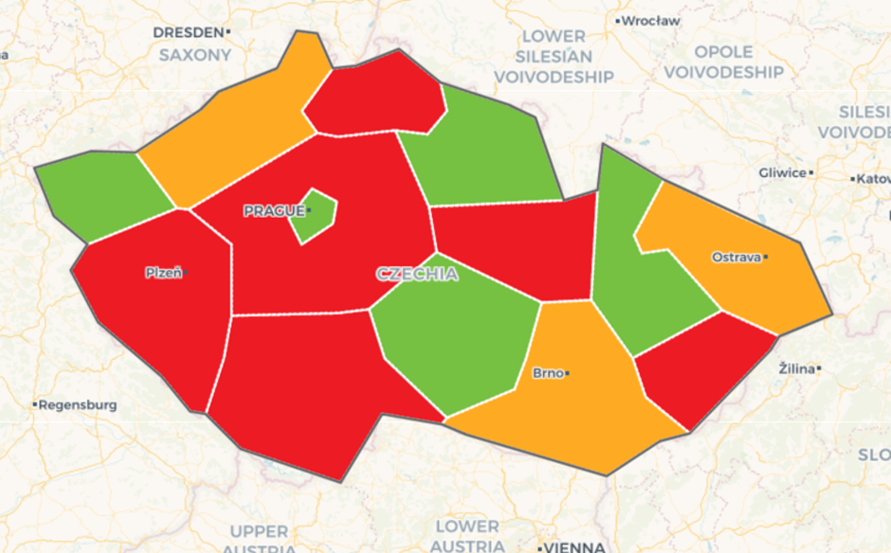
Regions overview – Czech Republic 2023
Region | Coverage | Hospital Performance | EMS Performance | Awareness | Region Status
Liberecký kraj | 100% | 50% | 0% | 0% | No
Královéhradecký kraj | 100% | 100% | 0% | 0% | No
Pardubický kraj | 100% | 0% | 100% | 4.59% | No
Jihočeský kraj | 100% | 66.67% | 100% | 109.26% | No
Plzeňský kraj | 50% | 0% | 100% | 0% | No
Moravskoslezský kraj | 100% | 83.33% | 100% | 104.01% | No
Karlovarský kraj | 100% | 100% | 100% | 90% | No
Ústecký kraj | 100% | 83.33% | 100% | 2.96% | No
Olomoucký kraj | 100% | 100% | 0% | 4.73% | No
Zlínský kraj | 100% | 0% | 100% | 0% | No
Středočeský kraj | 100% | 40% | 0% | 1.5% | No
Kraj Vysočina | 100% | 100% | 100% | 3.6% | No
Jimoravský kraj | 100% | 83.33% | 100% | 137.45% | No
Hlavní město Praha | 100% | 100% | 0% | 0% | No
SC PERFORMANCE

Slide 14
Emergency Medical Services performance for GOLD status in EMS Angels Awards
 | GOLD | PLATINUM | DIAMOND
Median time on scene (minutes) | 31 - 35 min | 25 - 30 min | < 25 minutes
% pre-notification to hospital | 85% | 90% | 95%
% of patients delivered to Stroke-Ready Hospitals: | 85% | 90% | 95%
% of patients where medications details are reported: | 85% | 90% | 95%
% of patients where time last known normal is reported: | 85% | 90% | 95%
31-35
min
85%
85%
Median time on scene
Pre-notification to hospital
Delivered to stroke-ready hospitals
85%
85%
Medication details reported
Time last known normal is reported

Slide 15
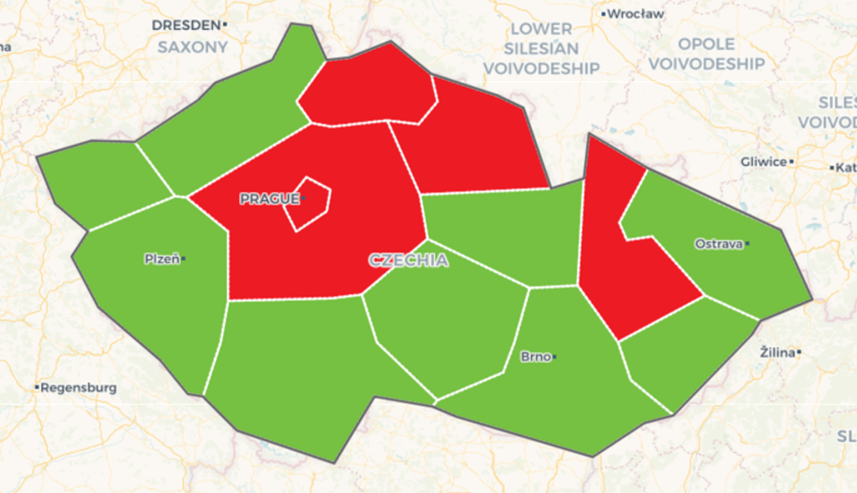
Regions overview – Czech Republic 2023
Region | Coverage | Hospital Performance | EMS Performance | Awareness | Region Status
Liberecký kraj | 100% | 50% | 0% | 0% | No
Královéhradecký kraj | 100% | 100% | 0% | 0% | No
Pardubický kraj | 100% | 0% | 100% | 4.59% | No
Jihočeský kraj | 100% | 66.67% | 100% | 109.26% | No
Plzeňský kraj | 50% | 0% | 100% | 0% | No
Moravskoslezský kraj | 100% | 83.33% | 100% | 104.01% | No
Karlovarský kraj | 100% | 100% | 100% | 0% | No
Ústecký kraj | 100% | 83.33% | 100% | 2.96% | No
Olomoucký kraj | 100% | 100% | 0% | 4.73% | No
Zlínský kraj | 100% | 0% | 100% | 0% | No
Středočeský kraj | 100% | 40% | 0% | 1.5% | No
Kraj Vysočina | 100% | 100% | 100% | 3.6% | No
Jimoravský kraj | 100% | 83.33% | 100% | 137.45% | No
Hlavní město Praha | 100% | 100% | 0% | 0% | No
EMS PERFORMANCE

Slide 16
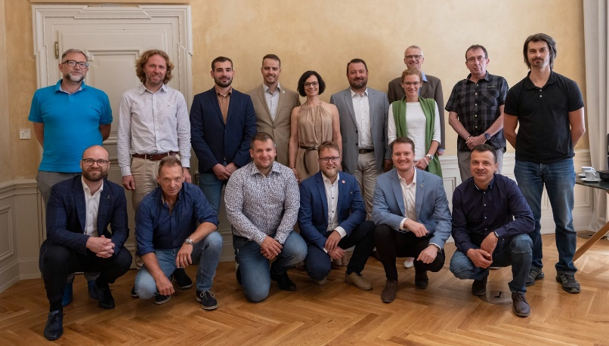
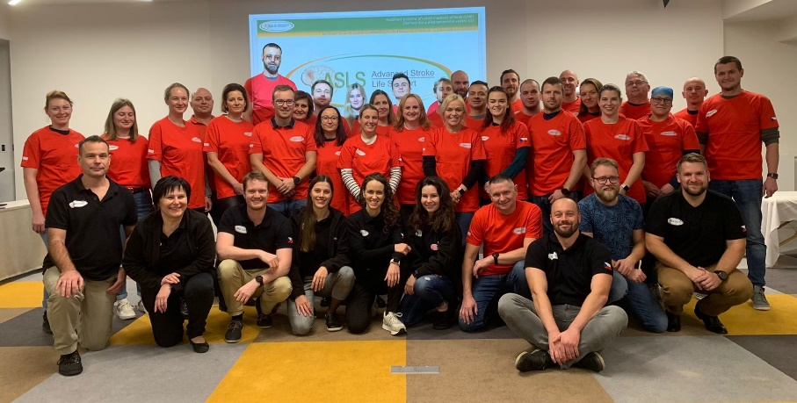
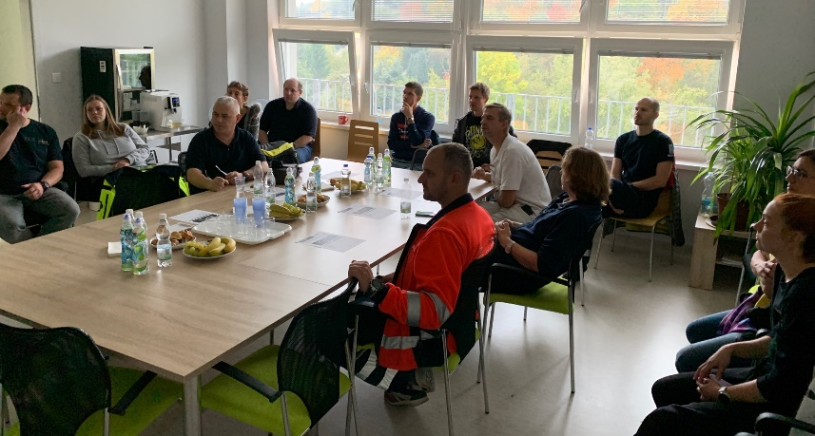
At the level of EMS
National EMS Angels Steering Committee
Quality Monitoring
(EMS Angels Awards)
EMS Education (Advanced Stroke Life Support, (sub) regional and local trainings)
EMS Steering Committee (all 14 EMS involved)
Prague - Advanced Stroke Life Support
SC Most – Seminar and patient visits for EMS

Slide 17
Awareness
Reach awareness education target through the implementation of FAST Heroes.
Additional awareness activities with Stroke Support Organizations
For every 1,000,000 inhabitants we assume 2,200 stroke patients (220 per 100,000 inhabitants). To educate the same number of patients we need half the number of children educated through FAST Heroes (each child educates two grandparents).
FAST Heroes
SAVING THE WORLD, ONE GRANDPARENT AT A TIME

Slide 18
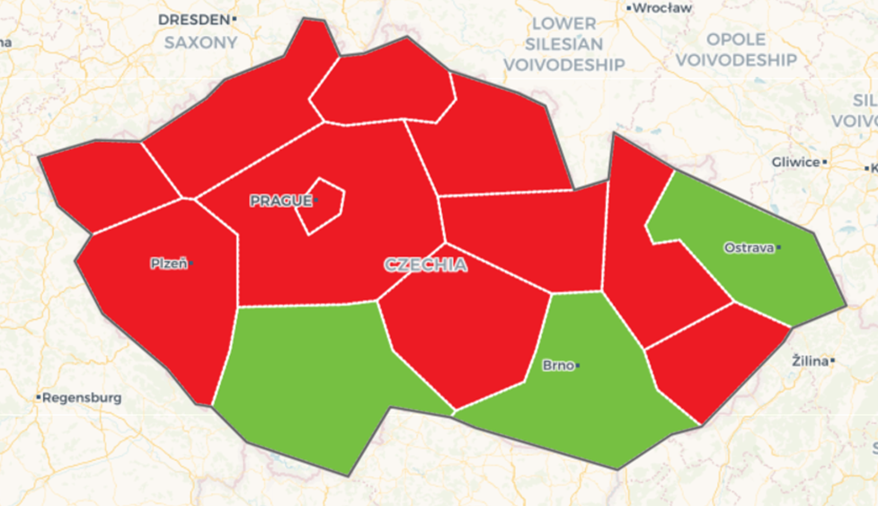
Regions overview – Czech Republic 2023
Region | Coverage | Hospital Performance | EMS Performance | Awareness | Region Status
Liberecký kraj | 100% | 50% | 0% | 0% | No
Královéhradecký kraj | 100% | 100% | 0% | 0% | No
Pardubický kraj | 100% | 0% | 100% | 4.59% | No
Jihočeský kraj | 100% | 66.67% | 100% | 109.26% | No
Plzeňský kraj | 50% | 0% | 100% | 0% | No
Moravskoslezský kraj | 100% | 83.33% | 100% | 104.01% | No
Karlovarský kraj | 100% | 100% | 100% | 90% | No
Ústecký kraj | 100% | 83.33% | 100% | 2.96% | No
Olomoucký kraj | 100% | 100% | 0% | 4.73% | No
Zlínský kraj | 100% | 0% | 100% | 0% | No
Středočeský kraj | 100% | 40% | 0% | 1.5% | No
Kraj Vysočina | 100% | 100% | 100% | 3.6% | No
Jimoravský kraj | 100% | 83.33% | 100% | 137.45% | No
Hlavní město Praha | 100% | 100% | 0% | 0% | No
AWARENESS – FAST HEROES

Slide 19
Awareness Performance (FAST Heroes)
SCHOOL SIGN-UPS
Level 2 Region | Jihozápad
Region | Jihočeský kraj
Number of Schools | 18
Number of Classes | 36
Learners Needed | 702
Current Learners | 814
Awareness | 115.95%

Slide 20
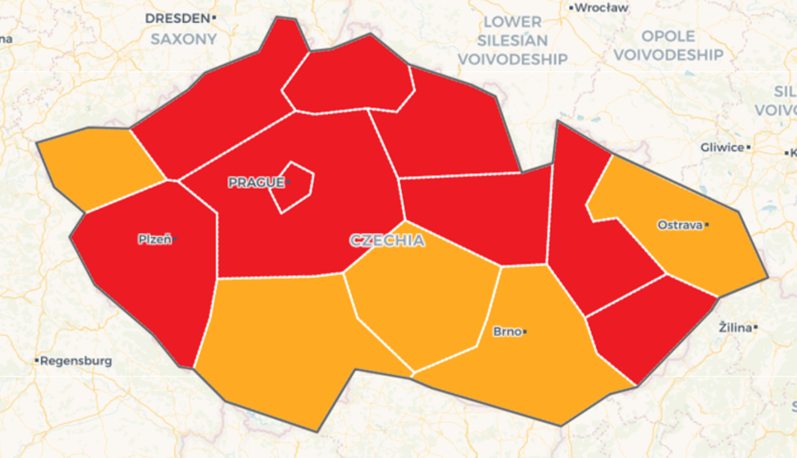
Regions overview – Czech Republic 2023
Region | Coverage | Hospital Performance | EMS Performance | Awareness | Region Status
Liberecký kraj | 100% | 50% | 0% | 0% | No
Královéhradecký kraj | 100% | 100% | 0% | 0% | No
Pardubický kraj | 100% | 0% | 100% | 4.59% | No
Jihočeský kraj | 100% | 66.67% | 100% | 109.26% | No
Plzeňský kraj | 50% | 0% | 100% | 0% | No
Moravskoslezský kraj | 100% | 83.33% | 100% | 104.01% | No
Karlovarský kraj | 100% | 100% | 100% | 90% | No
Ústecký kraj | 100% | 83.33% | 100% | 2.96% | No
Olomoucký kraj | 100% | 100% | 0% | 4.73% | No
Zlínský kraj | 100% | 0% | 100% | 0% | No
Středočeský kraj | 100% | 40% | 0% | 1.5% | No
Kraj Vysočina | 100% | 100% | 100% | 3.6% | No
Jimoravský kraj | 100% | 83.33% | 100% | 137.45% | No
Hlavní město Praha | 100% | 100% | 0% | 0% | No
REGION STATUS

Slide 21
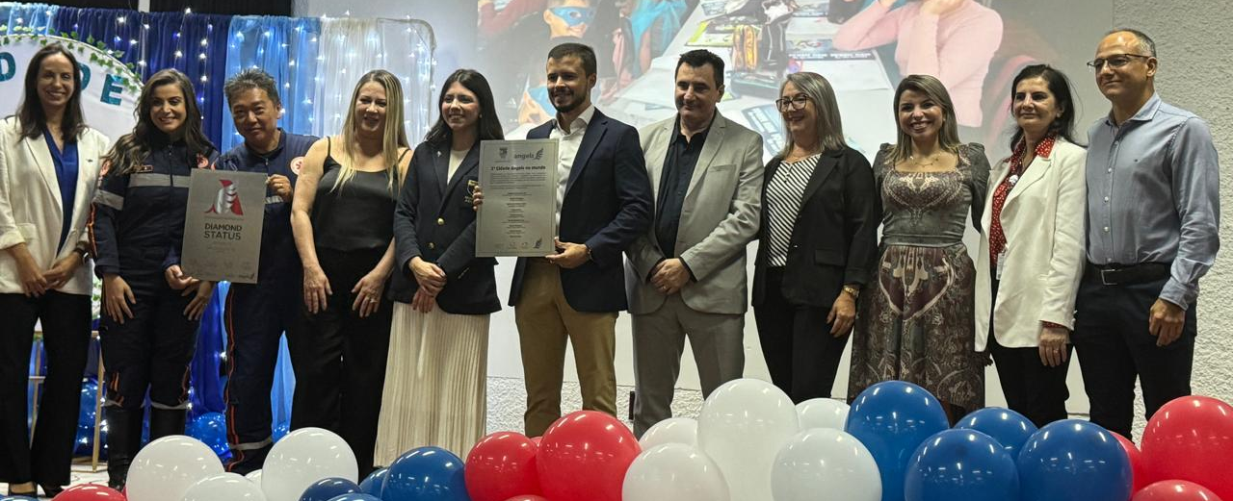
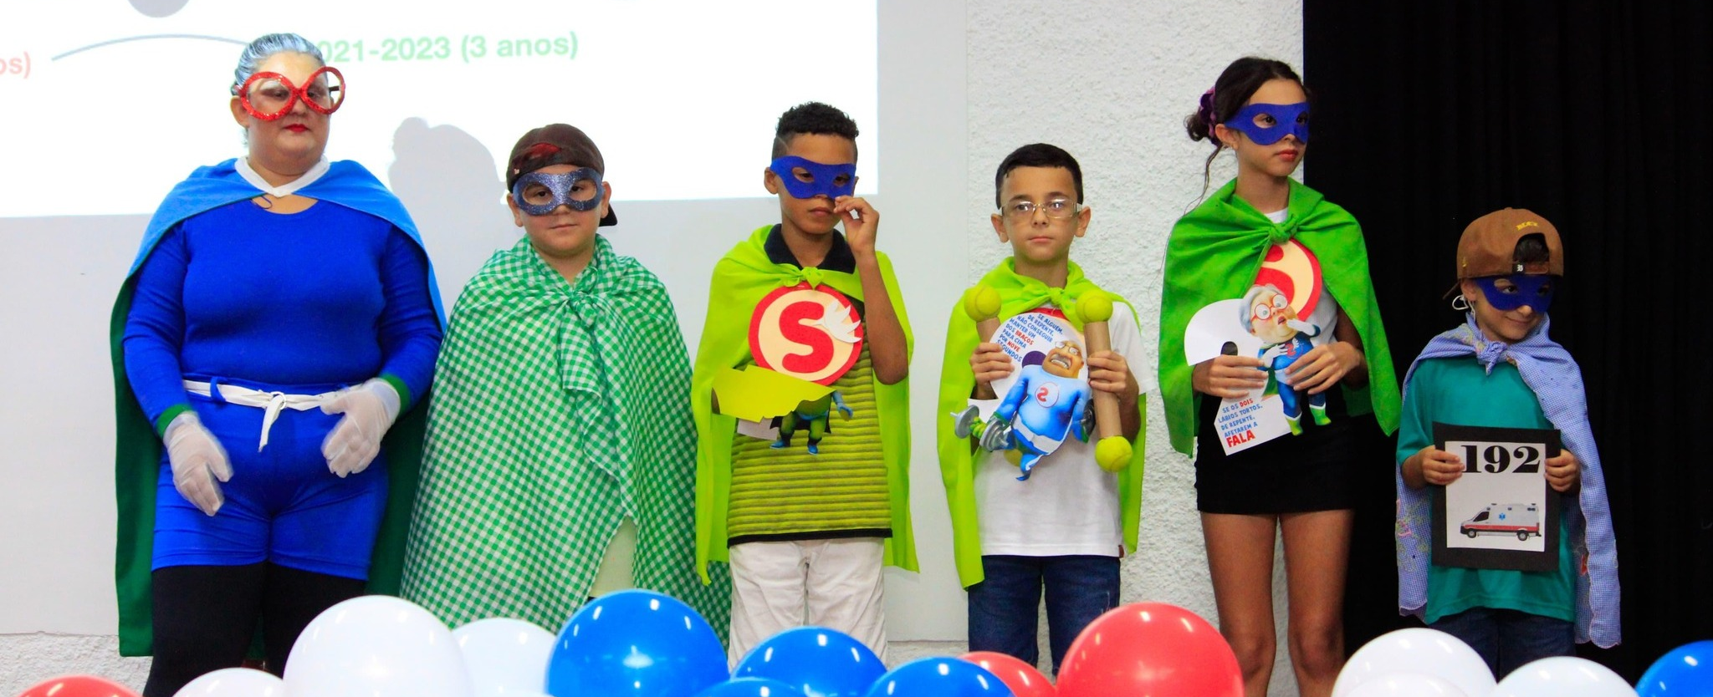
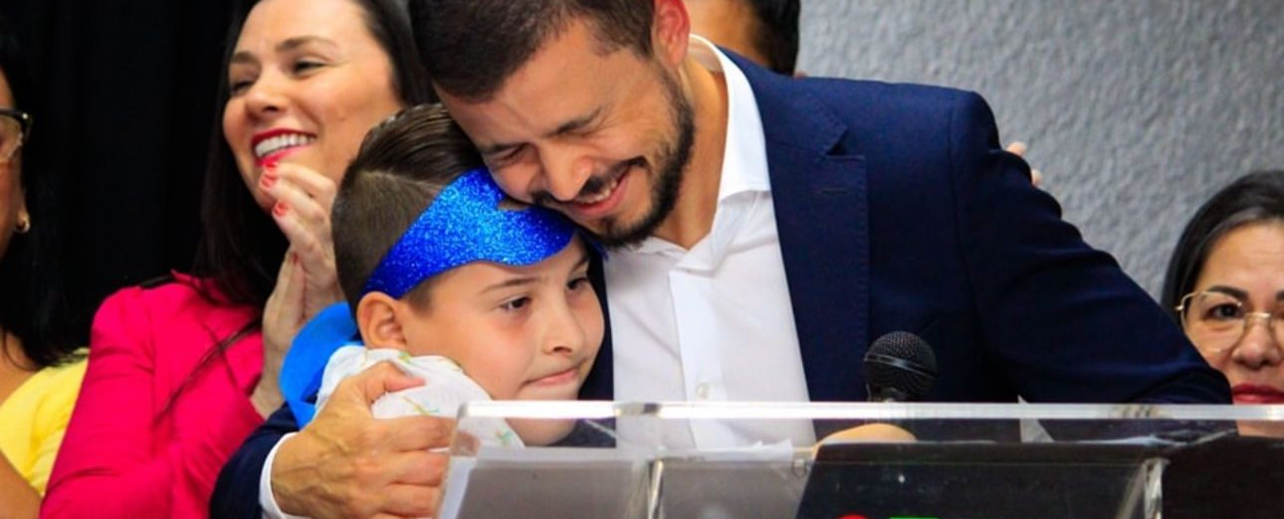
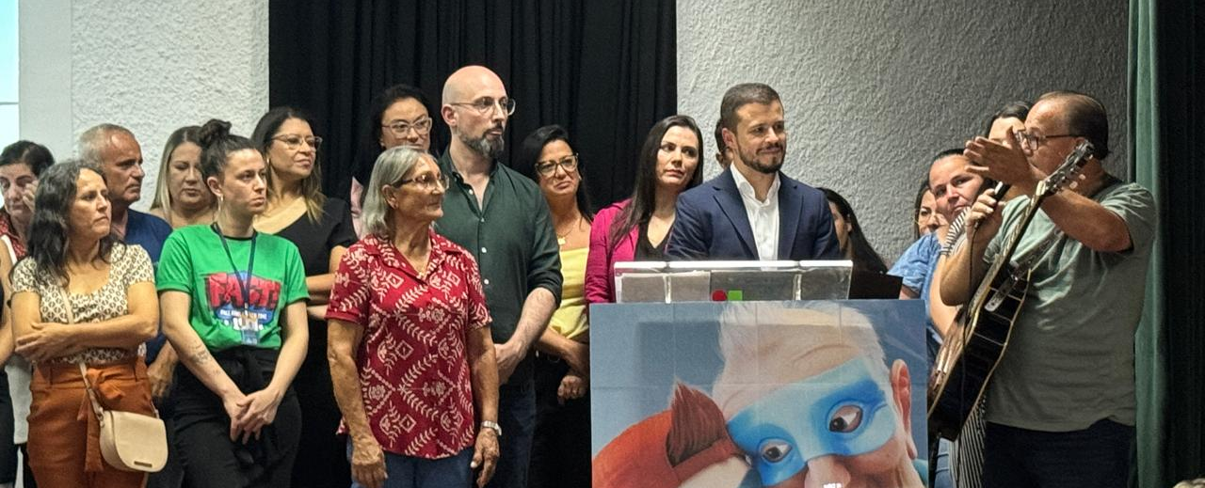
Angels City Ceremony – Sapucaia do sul, Brazil

Slide 22
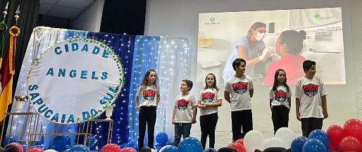
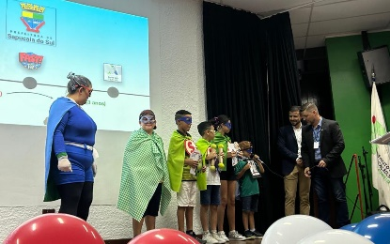
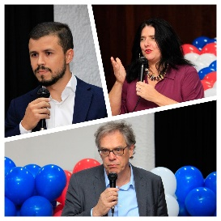
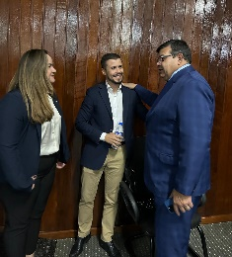
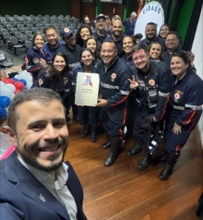
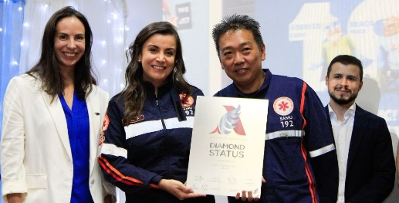
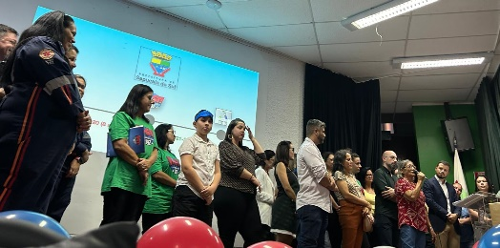
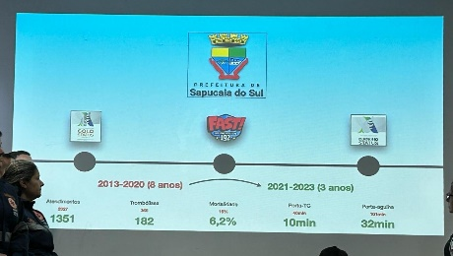
Angels Region
STROKE SYMPTOM RECOGNITION
(Awareness campaign)
COVERAGE
(Involve heath authorities)
PRE-HOSPITAL CARE
HOSPITAL CARE

Slide 23
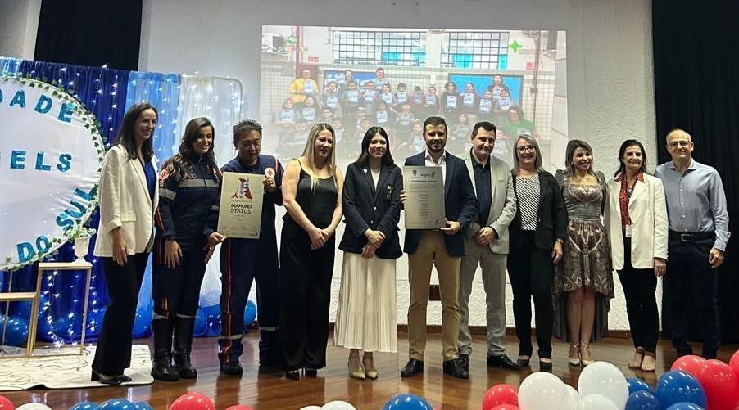
The power of celebrating together
All the people involved in the process
Schools (teachers and children)
Mayor
Ministry of Health/Education
EMS
Hospitals
Patients
STROKE IS NO LONGER JUST OUR PRIORITY; IT IS NOW EVERYONE'S PRIORITY, WORKING TOWARDS THE SAME GOAL.

Slide 24
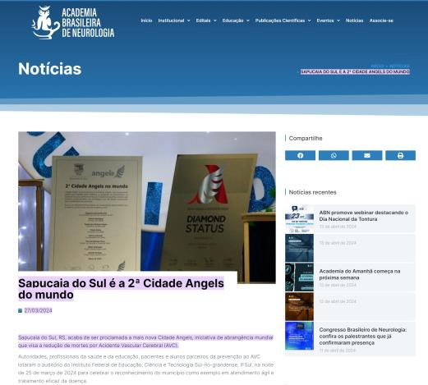
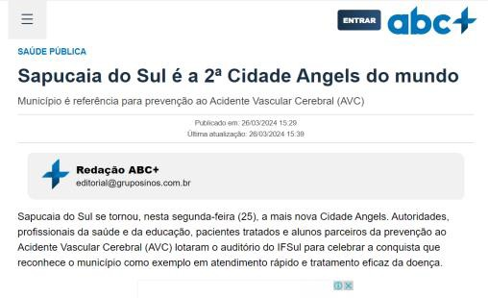
Press releases & media Now more regions want to join the movement!

